Slide 1

FBLA Computer game and simulation
Jack Phillips

Slide 2

task
Geared toward middle school students
Develop[ competent business skills

Slide 3

Challenges
Engaging yet educational gameplay
Unique theme and art style

Slide 4

Process
Content
Style, storyboard
Platform
Design and development
debugging

Slide 5

content
Real world business challenges
Charisma
Negotiation
Leadership
Time management
learning

Slide 6
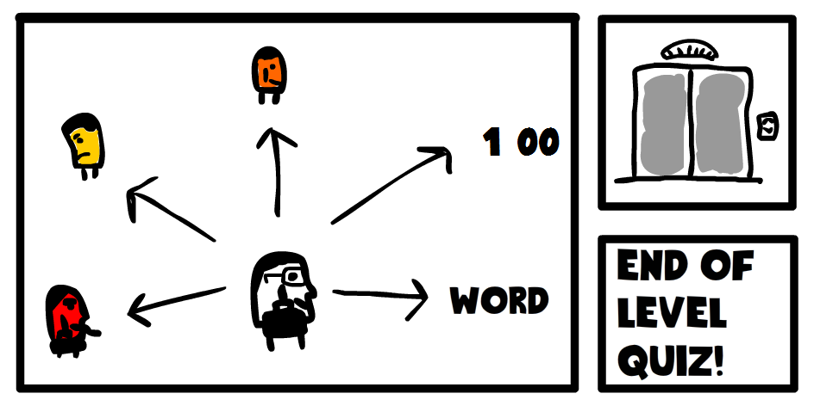
storyboard

Slide 7


tools
Adobe Flash
Github

Slide 8
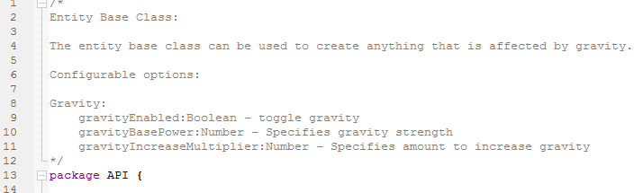
Development
Wrote our own api
Used actionscript and inheritance
Extensive documentation

Slide 9
Uml inheritance diagram
Environment
flash.event.Event
Spawner
<<abstract>>
Sensor
Entity
<<abstract>>
EntityEvent
Player
FallingSpike
nextLevel_sensor

Slide 10

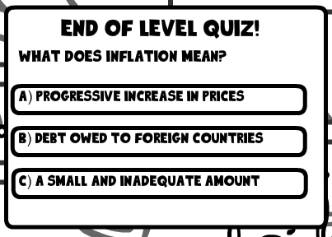
User interaction
End of level quiz
Guide

Slide 11

design
Doodle style
Black and white
Real world working place
Backgrounds are business themed

Slide 12


Slide 13
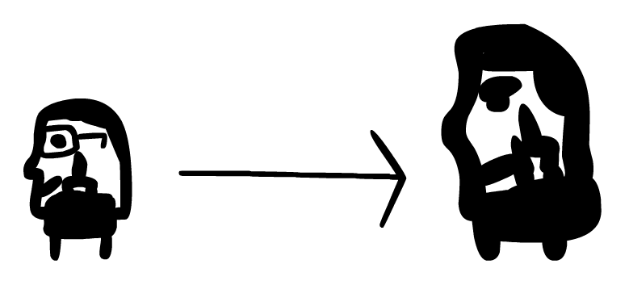
progression
learning

Slide 14
demo

